Slide 1
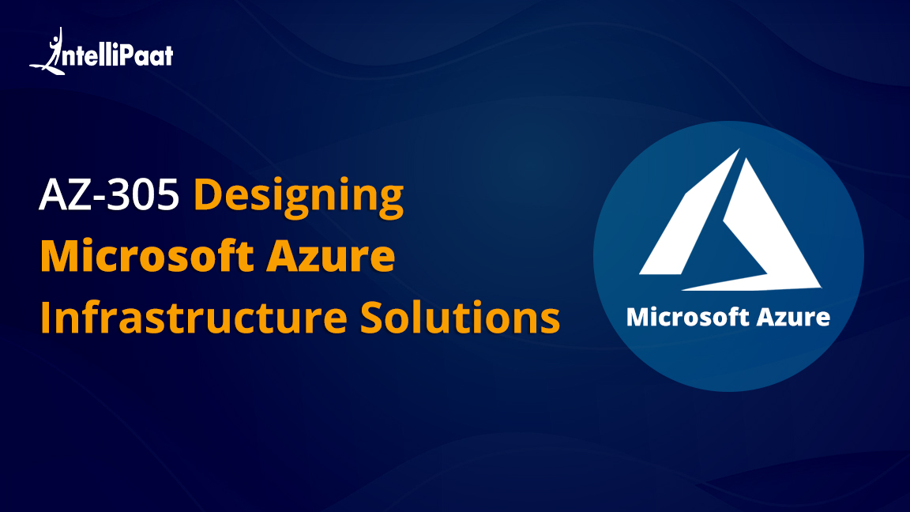

Slide 2
Agenda
MODULES
01
Design identity, governance, and monitor solutions
02
Design business continuity solutions
03
Design data storage solutions
04
Design infrastructure solutions

Slide 3
1
Design identity, governance, and monitor solutions

Slide 4
Azure Monitor

Slide 5



What is Azure Monitor?
Azure Monitor is a service to maximize the productivity of our Azure services and applications by providing a solution for collecting, analyzing, and acting on telemetry from our cloud and on-premises environments
Collecting
Generating Alerts
Analyzing

Slide 6
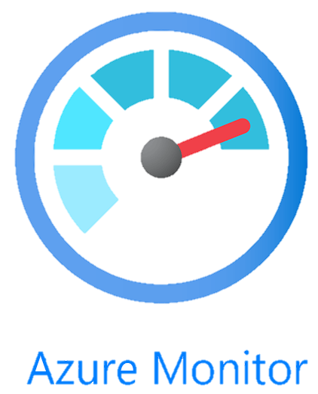
Why do we need Azure Monitor?
These are some of the use cases where Azure Monitor is used:

Slide 7
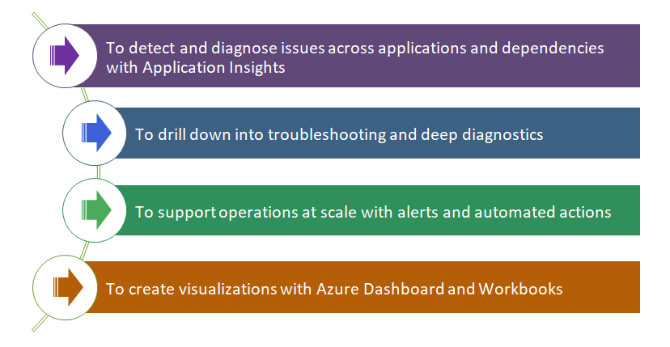
Why do we need Azure Monitor?
These are some of the use cases where Azure Monitor is used:

Slide 8
Why do we need Azure Monitor?
These are some of the use cases where Azure Monitor is used:

Slide 9
Why do we need Azure Monitor?
These are some of the use cases where Azure Monitor is used:

Slide 10
Why do we need Azure Monitor?
These are some of the use cases where Azure Monitor is used:

Slide 11
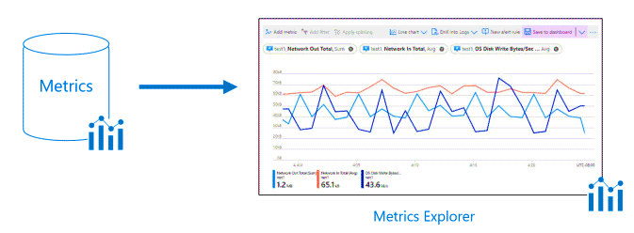
What is Azure Monitor?
Azure Monitor is made up of two data types: Metrics and Logs

Slide 12
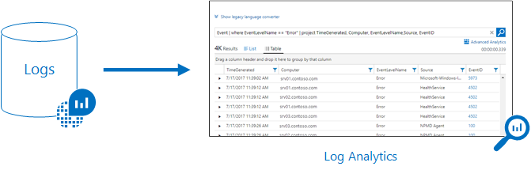
What is Azure Monitor?
Azure Monitor is made up of two data types: Metrics and Logs

Slide 13
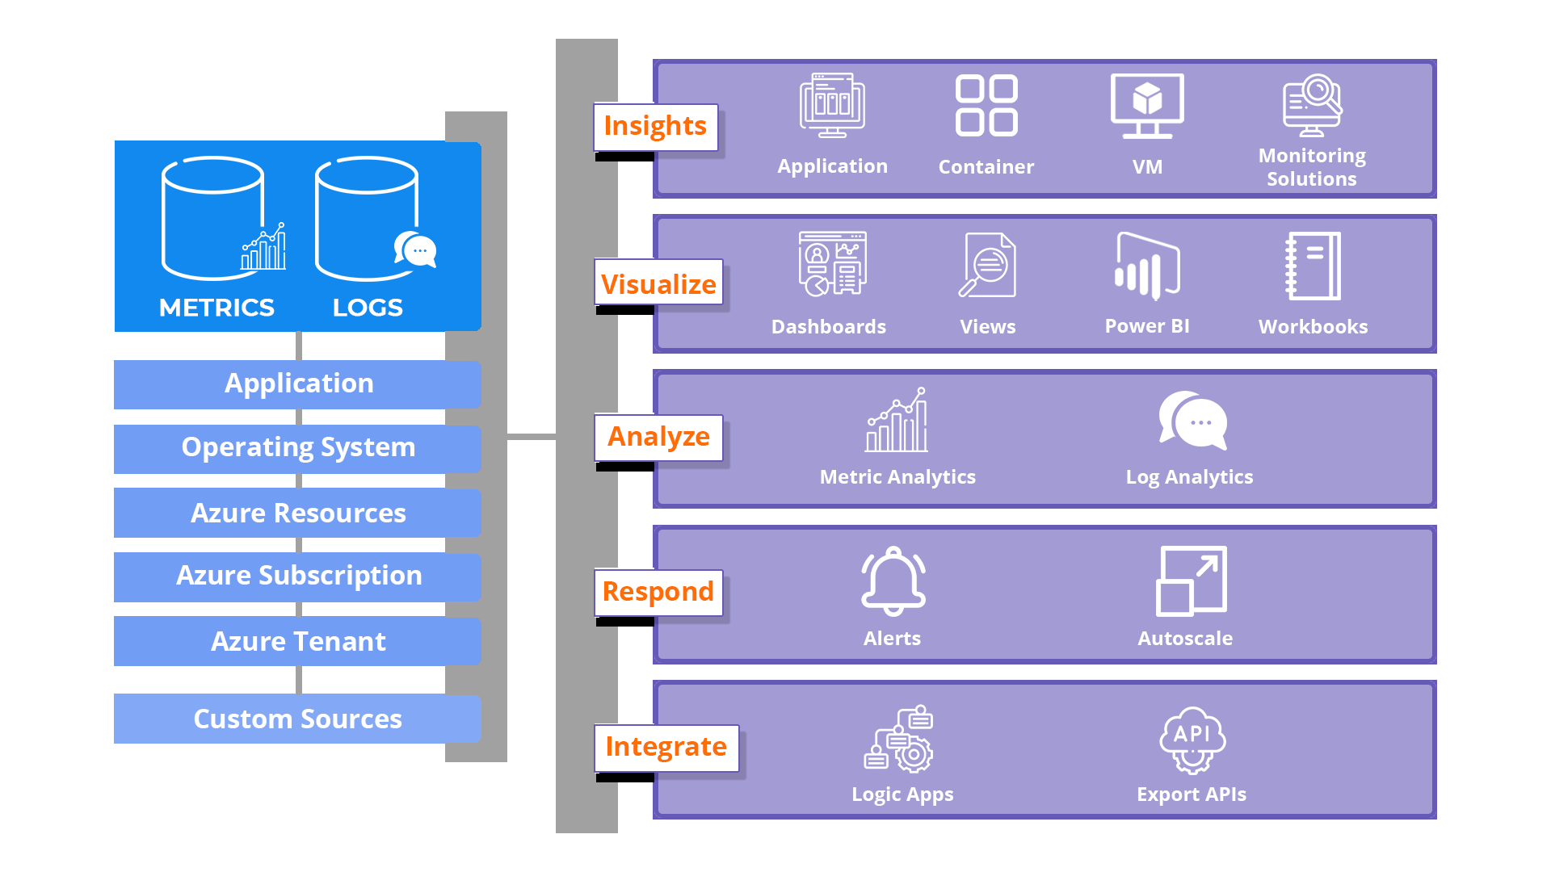
An Overview of the Working of Azure Monitor
In the center of the below chart, we have the two data stores, Metrics and Logs. In the left side, we have the sources of monitoring data, and in the right side is a list of services provided by Azure Monitor based on the data collected

Slide 14
Azure Metrics

Slide 15


What are Metrics?
Metrics are introduced in Azure Monitor particularly for the faster alerting and detecting of issues. These values are used to describe one aspect of a system at a time. In Azure Monitor, they are lightweight and capable of supporting near real-time scenarios

Slide 16

Azure Metrics: The Structure of Data
The data collected by Azure Metrics is a time-series database
Each set of metric values is a time-series data with the following properties:
The time the value is collected.
The resource the value is associated with.
A namespace that acts like a category for the metric.
A metric name,
The value itself

Slide 17
Azure Log Analytics

Slide 18

What are Logs?
Logs are essentially used to describe events, collected sporadically. They are numerical data combined with text in the form of detailed descriptions. Telemetry such as events and traces is stored in Azure Monitor Logs, in addition to the performance data, so that it can all be combined for analysis

Slide 19

Azure Log: The Structure of Data
All logs in Azure Monitor are stored in the Log analytics workshop.
They are stored in the form of multiple tables
All tables share some common properties. However, each has a unique set of properties depending on the kind of data it stores
A new workspace will have standard set of tables, and more tables will be added by different monitoring solutions and other services that write to the workspace

Slide 20
Alerts and Actions

Slide 21

What are Alerts?
In Microsoft Azure, alerts are used to notify important conditions. They are the result of the continuous monitoring of data, and they reach out to the owner of the system before users do so that the owner will be able to address issues first
The previous alert experience and alert types are called classic alerts

Slide 22
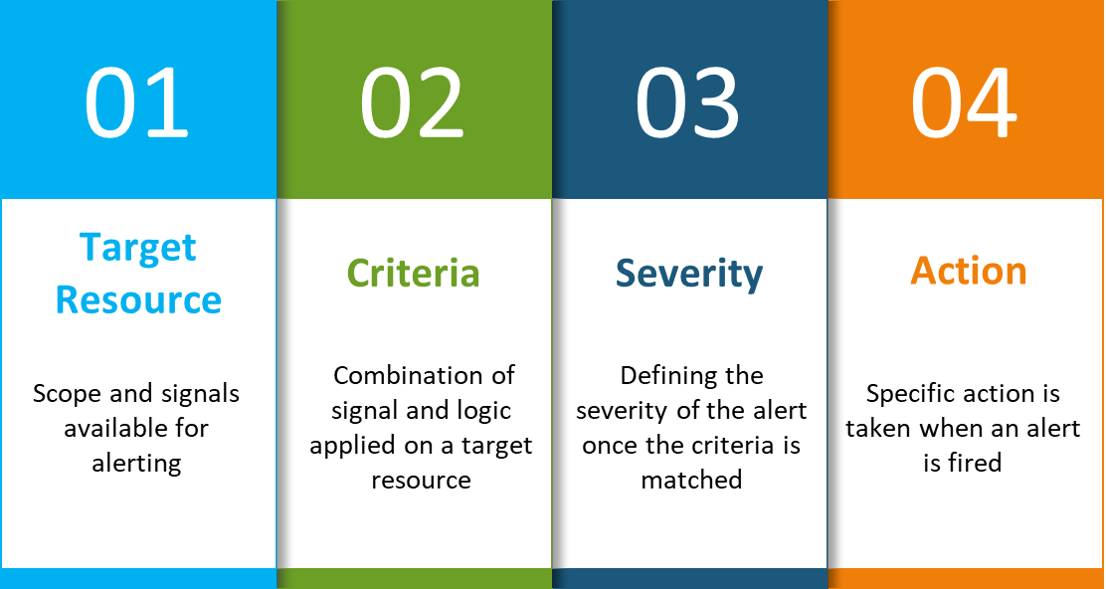
Workflow of Alert Rule
The following are the key attributes of an alert rule:

Slide 23
Workflow of Alert Rule
The following are the key attributes of an alert rule:

Slide 24
Workflow of Alert Rule
The following are the key attributes of an alert rule:

Slide 25
Workflow of Alert Rule
The following are the key attributes of an alert rule:

Slide 26
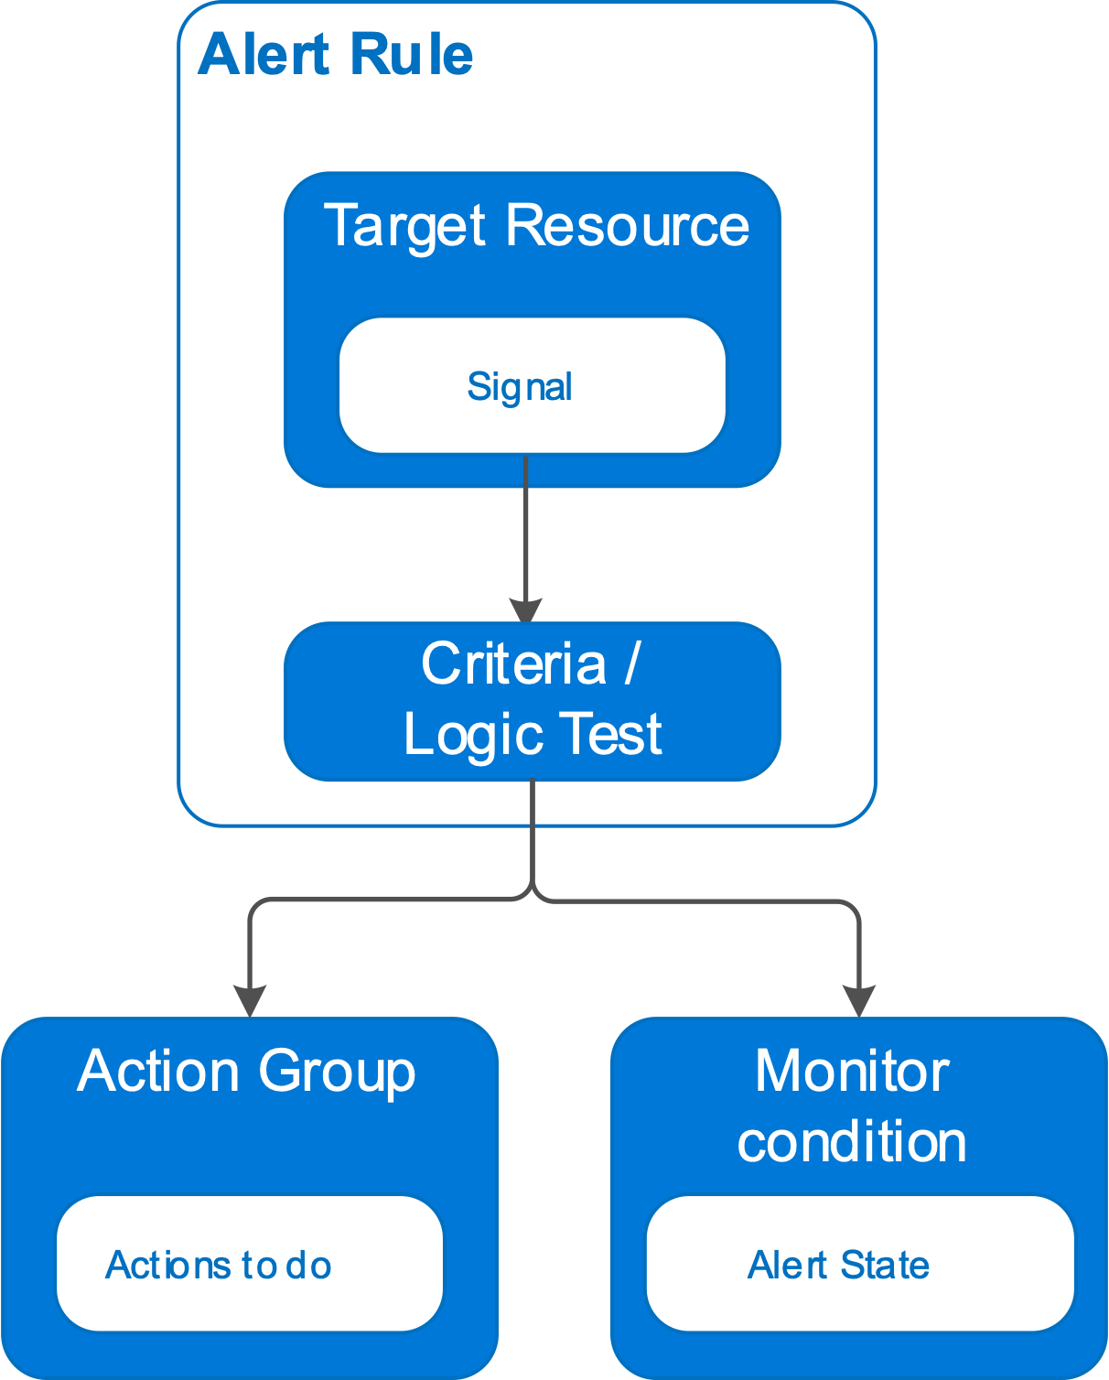
Workflow of Alert Rule
The following are the key attributes of an alert rule:

Slide 27
Azure Workbook and Azure Insights

Slide 28


Azure Workbook and Azure Insights
Within the Azure site, workbooks provide a versatile canvas for data analysis and the creation of sophisticated visual reports. Insights allows you to tailor your monitoring experience for specific applications and services. Both logs and metrics are collected and analysed.

Slide 29
Azure Application Insights

Slide 30

What are Application Insights?
Application Insights is a service provided by Microsoft Azure to monitor our applications that are live. It automatically deals with performance anomalies and uses powerful analytical tools to understand how users are working with the application

Slide 31

How does Application Insights work?
Install a small instrumentation package in our application

Slide 32
How does Application Insights work?
Install a small instrumentation package in our application
Set up an Application Insights resource in Microsoft Azure Portal

Slide 33




Azure Data Explorer
Azure Data Explorer is suitable for examining massive amounts of data from a variety of sources, including websites, applications, IoT devices, and more.
Data Explorer

Slide 34
Backup Reports

Slide 35

Why do we need Backup Reports?
Azure Backup is a service provided by Azure to help get rich and deep insights on the backup reports. This includes allocating and forecasting cloud storage consumed, auditing backup and restore, and identifying key trends
Backup Data

Slide 36
Recovery Service Vaults

Slide 37
What are Recovery Service Vaults?
Recovery service vaults are a storage entity provided by Microsoft Azure to store different types of data. The data may include copies of other data and the configuration information for VMs, workloads, servers, or workstations
What are the specific uses of Recover service vaults?
Holding backup data for various Azure services
Supporting System Center DPM, Windows Server, Azure Backup Server, and more
Making it easier to organize our backup data, while minimizing management overhead

Slide 38
Backing Up an Azure VM

Slide 39

What is Azure Backup Service?
Azure offers a built-in backup service that lets users backup their data to the Microsoft Azure Cloud. This service can also be used to take on-point backups of Azure VMs
VM backups in Azure are stored in Recovery Service vaults. We can access these Recovery Service vaults through Azure Portal

Slide 40
What is Azure Backup Service?
Azure offers a built-in backup service that lets users backup their data to the Microsoft Azure Cloud. This service can also be used to take on-point backups of Azure VMs
VM backups in Azure are stored in Recovery Service vaults. We can access these Recovery Service vaults through Azure Portal

Slide 41
What is Azure Backup Service?
Azure offers a built-in backup service that lets users backup their data to the Microsoft Azure Cloud. This service can also be used to take on-point backups of Azure VMs
VM backups in Azure are stored in Recovery Service vaults. We can access these Recovery Service vaults through Azure Portal
Azure gives full flexibility to configure and modify a VM backup

Slide 42
What is Azure Backup Service?
Azure offers a built-in backup service that lets users backup their data to the Microsoft Azure Cloud. This service can also be used to take on-point backups of Azure VMs
VM backups in Azure are stored in Recovery Service vaults. We can access these Recovery Service vaults through Azure Portal
Azure gives full flexibility to configure and modify a VM backup
We can choose when to create a backup according to the time that works best for us

Slide 43
What is Azure Backup Service?
Azure offers a built-in backup service that lets users backup their data to the Microsoft Azure Cloud. This service can also be used to take on-point backups of Azure VMs
VM backups in Azure are stored in Recovery Service vaults. We can access these Recovery Service vaults through Azure Portal
Azure gives full flexibility to configure and modify a VM backup
We can choose when to create a backup according to the time that works best for us
We can keep a backup enabled as long as we want

Slide 44
What is Azure Backup Service?
Azure offers a built-in backup service that lets users backup their data to the Microsoft Azure Cloud. This service can also be used to take on-point backups of Azure VMs
VM backups in Azure are stored in Recovery Service vaults. We can access these Recovery Service vaults through Azure Portal
Azure gives full flexibility to configure and modify a VM backup
We can choose when to create a backup according to the time that works best for us
We can keep a backup enabled as long as we want
Recovery Service vaults are connected to our storage account and scale automatically to accommodate our backup

Slide 45
What is Azure Backup Service?
Azure offers a built-in backup service that lets users backup their data to the Microsoft Azure Cloud. This service can also be used to take on-point backups of Azure VMs
VM backups in Azure are stored in Recovery Service vaults. We can access these Recovery Service vaults through Azure Portal
Azure gives full flexibility to configure and modify a VM backup
We can choose when to create a backup according to the time that works best for us
We can keep a backup enabled as long as we want
Recovery Service vaults are connected to our storage account and scale automatically to accommodate our backup
Azure backup is a pay-as-you-go service, i.e., we need to only pay for the storage amount we use

Slide 46

Restoring a Backup
Create a New VM
We quickly create and get a basic VM up and running from a restore point. We can specify a name for the VM and a storage account for the restored VM
1

Slide 47
Restoring a Backup
Create a New VM
We quickly create and get a basic VM up and running from a restore point. We can specify a name for the VM and a storage account for the restored VM
1
2
Restore the Disk
Restores a VM disk, which can then be used to create a new VM. Alternatively, we can attach the disk to an existing VM

Slide 48
Restoring a Backup
Create a New VM
Replace the Existing
We quickly create and get a basic VM up and running from a restore point. We can specify a name for the VM and a storage account for the restored VM
We can restore a disk and use it to replace the disk on the existing VM. The current VM must exist. If it's being deleted, this option can't be used
1
2
3
Restore the Disk
Restores a VM disk, which can then be used to create a new VM. Alternatively, we can attach the disk to an existing VM

Slide 49
What is Access Management in Azure?

